Slide 1
Name of Speech
Name of Speaker
Title
Affiliation

Slide 2
Acknowledgement
The presenter wishes to acknowledge the IEEE Vehicular Technology Society for their kind support under the Distinguished Lecturer program.

Slide 3
About the Vehicular Technology Society
More than 6,200 members across 120 countries of diverse fields, career stages, disciplines, and professions
Worldwide: 42 Chapters 25 Joint Chapters 13 Student Branch Chapters (and counting!)
IEEE’s first society, established in 1949

Slide 4
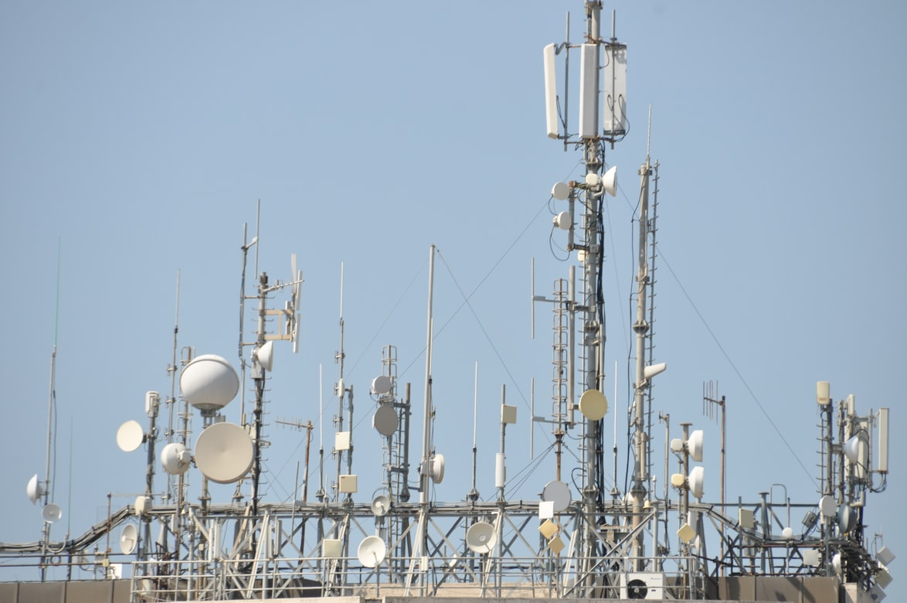
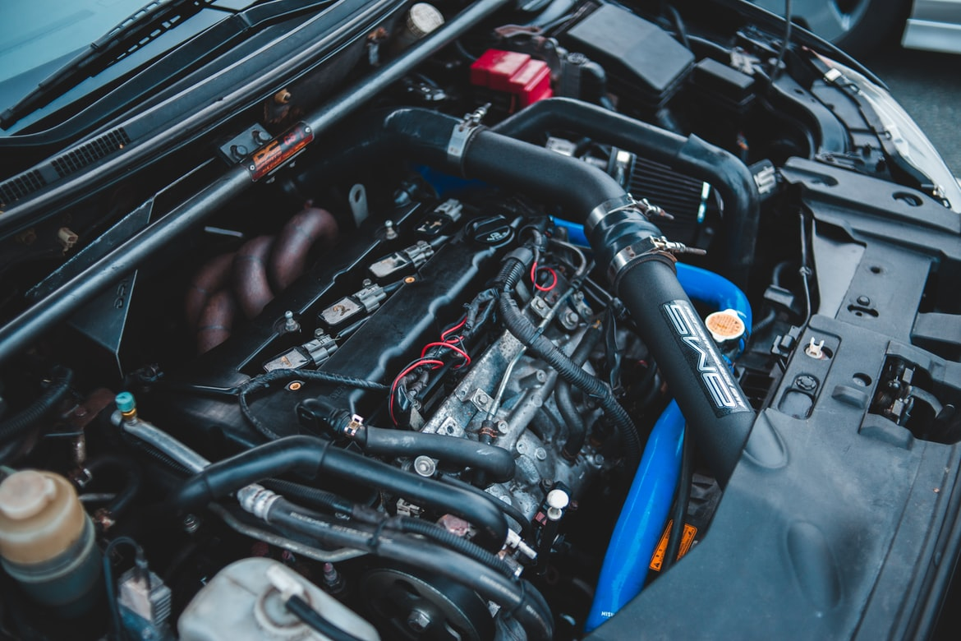
Scope & Focus
Mobile Radio
Land Transportation
Motor Vehicles

Slide 5
What can VTS do for you?
Conferences
Publications
Awards
Standards
Education

Slide 6
Conferences - VTC
Vehicular Technology Conference (VTC)
Biannual Flagship Conference
Founded in 1950
500 to 700 attendees
100th edition: VTC2024-Fall

Slide 7
Conferences – VPPC, WAC, JRC
Vehicular Power & Propulsion Conference
Wireless Africa
Joint Rail Conference (co-sponsored with ASME)

Slide 8
Publications
Vehicular Technology Magazine
Transactions on Vehicular Technology
Open Journal on Vehicular Technology
A printed copy sent to all VTS Members
Impact Factor of 11.7
Published quarterly
Easy online access with PageRaft
Monthly issues
Impact Factor of 6.8
5,600 paper submissions annually
12,000 publication pages
New technical area - Connected and Autonomous Vehicles Systems
Submission-to-publication: 10 weeks
Impact Factor of 6.4
Focus on emerging technical areas
Accelerated track with discounts for VTC papers
New best paper award

Slide 9
Other Co-Sponsored Publications
IEEE Transactions on Big Data
IEEE Wireless Communications Letters
IEEE Network Letters
IEEE Transactions on Transportation Electrification
IEEE Access – VT Section
IEEE Transactions on Intelligent Vehicles
IEEE Communication Standards Magazine
IEEE Transactions on Green Communications and Networking
IEEE Transactions on Machine Learning in Communications and Networking
IEEE Transactions on Radar Systems

Slide 10
Distinguished Lecturers & Speakers Program
Objective
Highlights
Information
Providing VTS chapters with presentations by leading experts on topics of interest to VTS Members
65+ Distinguished Lecturers and Speakers
Online Biography, Technical Area, and Topics of Interest
Request a DL or DS for your event by visiting the website and filling out the form.
Become a Distinguished Lecturer - calls for new DLs are announced on the website and social media.
vtsociety.org

Slide 11
Awards
Service Awards
Stuart Meyer Memorial
VTS Outstanding Service
Technical Awards
James Evans Avant Garde
VTS Hall of Fame
Best Paper Awards
Best Land Transportation Paper
Neal Shepherd Memorial Best Propagation Paper
Jack Neubauer Memorial
Best Vehicular Electronics Paper
Best Magazine Paper
Best OJVT Paper
Membership Awards
VTS Early Career
VTS Women’s Distinguished Career
VTS Chapter-of-the-Year
Fellowships
Daniel E. Noble Fellowship
Transportation Electronics Fellowship
Student Scholarship Award

Slide 12
Standards
FIELDS OF INTEREST
Automated Vehicles
High Speed Train and Maglev
Mobile Radio
Traction Power Systems
Communications Based Train Control and Signals
Intelligent Transportations Systems
Overhead Contact Systems
IEEE standards drive the functionality, capabilities and interoperability of a wide range of products and services that transform the way people live, work and communicate. VTS is one of the IEEE Societies that develops standards under the IEEE Standards Association.
Learn more at https://standards.ieee.org/

Slide 13
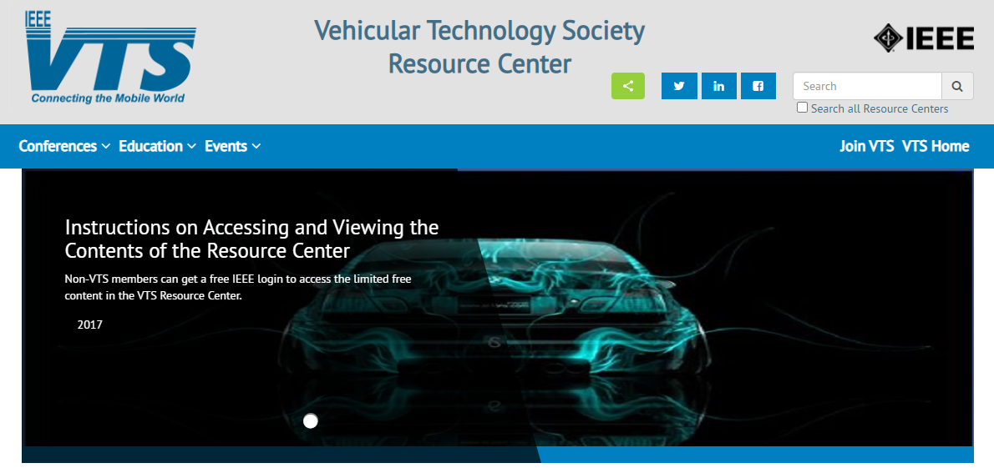
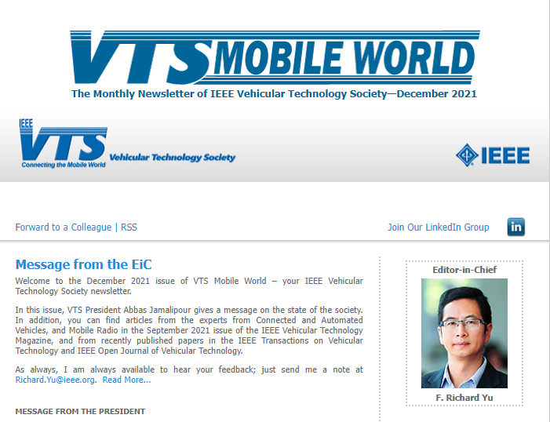
Educational Resources
VTS Resource Center
Free to VTS Members
Conference & Event Recordings
Tutorials
Webinars
Visit https://resourcecenter.vts.ieee.org/
VTS Mobile World
Free monthly e-newsletter
President & Board of Governors Reports
Breaking News
Upcoming Events

Slide 14
Join a Chapter
Stay current on Vehicular Technology
Access our 65+ Distinguished Lecturers and Speakers
Network and build community
Regional training with travel support
Visit www.ieee.org

Slide 15
Website
www.vtsociety.org
Facebook
facebook.com/IEEEVTS
Stay up to date on all VTS news and events!
Twitter
@IEEE_VTS
LinkedIn
www.linkedin.com/company/ieee-vehicular-technology-society

