Slide 1
75 years of IEEE Vehicular Technology Society

Slide 2
The Vehicular Technology Society was first established within the Institute of the Radio Engineers (IRE) under the name IRE Professional Group on Vehicular Communications (PGVC) in 1949.

Slide 3
VTS Membership Growth: 1950 to 2024
“...on June 1, 1950 there were 184 members, on December 20, 1950 there were 383 members and by February of 1951 the members stood at 413.”
As of October 8, 2024, IEEE VTS has 8,140 members.

Slide 4
1951 to 2024:
Membership Dues
The annual membership fee in 1951 was USD $2.
In 2024, the annual regular membership is USD $18.

Slide 5
1967: Why join VTG?
“I feel that the most positive aspect of VTG membership is the opportunity it provides to participate in the local and national activities of the group.”

Slide 6
1965-1975: VTG Standard Activities

Slide 7
1975: VTS Administrative Committee Members

Slide 8
1980s: VTS sponsors job project in Detroit
During economic recession in the 1980s, IEEE VTS offered timely help to engineers in Detroit.

Slide 9
February 2000: IEEE VTS Board of Governors Meeting

Slide 10
2001: Board of Governors Meeting

Slide 11
2006: First issue of the IEEE Vehicular Technology Magazine

Slide 12
2007: First IEEE VT Magazine Best Paper Award

Slide 13
2009: IEEE VTS North America Region Chapter Chair Meeting,Chicago

Slide 14
2010: IEEE VTS Asian Pacific Region (APR) Chapters Chair Meeting, Taipei

Slide 15
2010: Launch of Distinguished Lecturer Program
In 2010, IEEE VTS launched its Distinguished Lecturer and Speaker Program.
By 2017, the DL program was one of the largest in IEEE.
The DL program now has over 75 speakers, with over 110 talks reported online and across the globe in the last two years.

Slide 16
2013: VT Traction Power Modeling Standard Committee Meeting

Slide 17
2015: 40 Years of Automotive Electronics, VT Magazine
Written by Senior Editor Bill Fleming

Slide 18
2016: Launch of VTS Mobile World Newsletter

Slide 19
2016: Launch of IEEE VTS Resource Center
In 2016, VTS launches the IEEE VTS Resource Center.

Slide 20
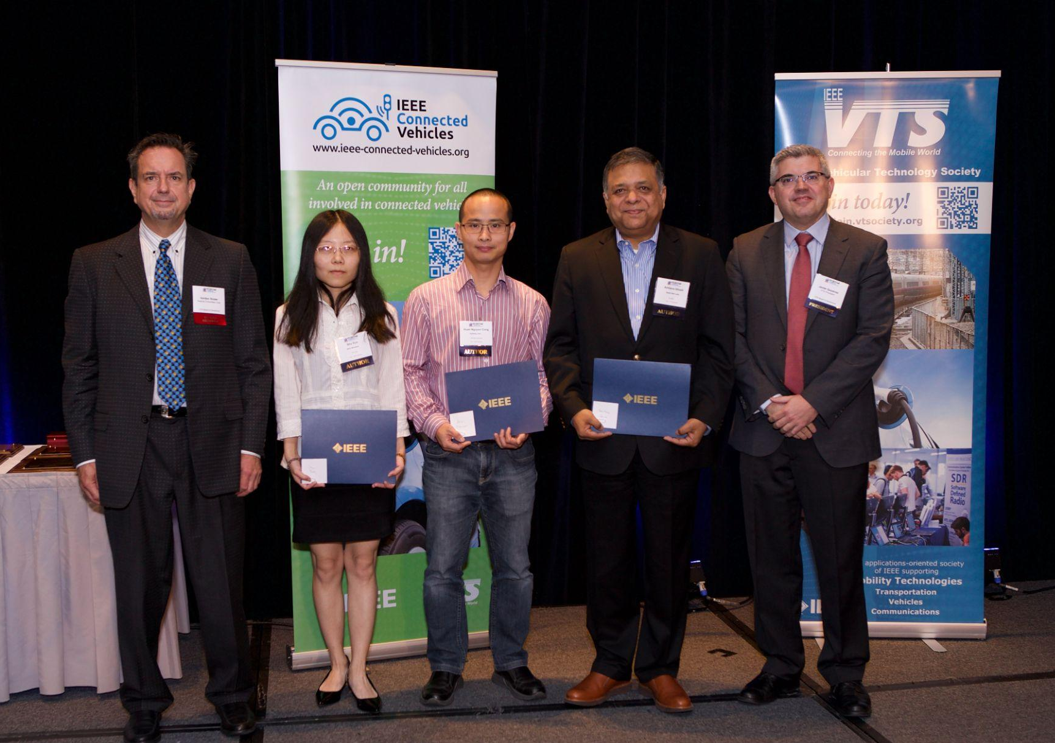
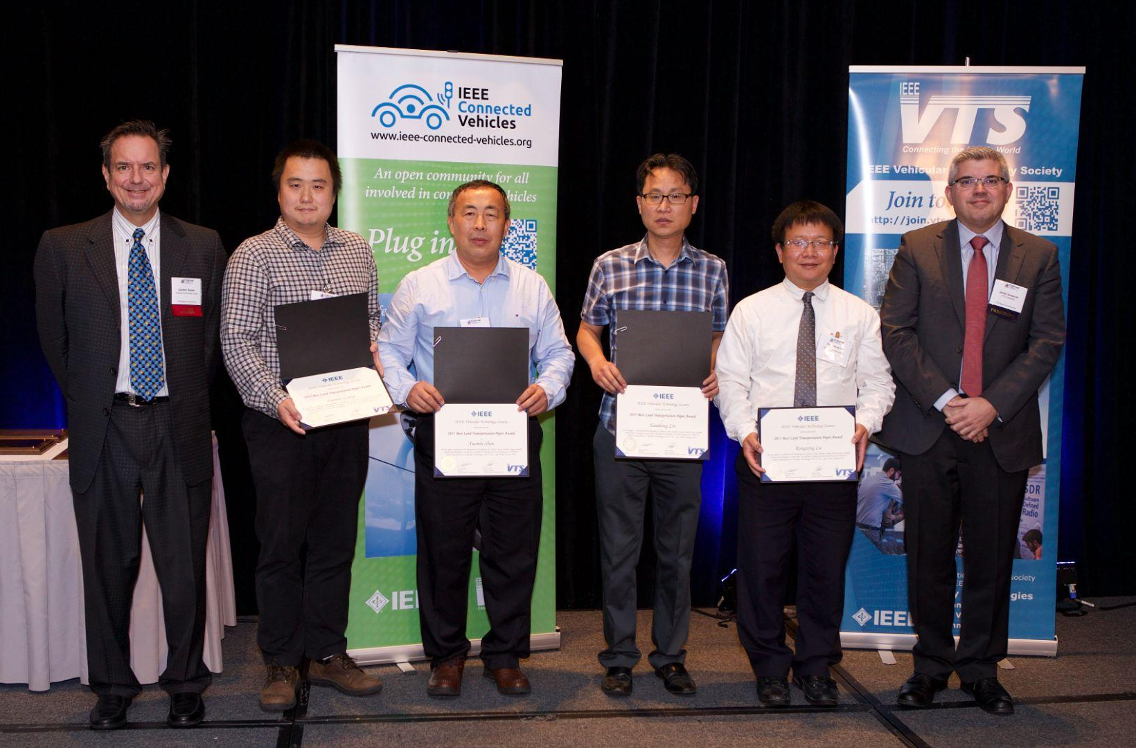
2017: VTS Awards

Slide 21
2017: Communication-Based Train Control Standards meeting, New Jersey

Slide 22
2017: IEEE CDMA milestone event

Slide 23
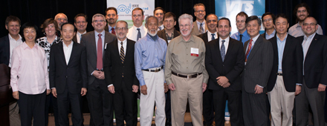
2017: VTS Board of Governors Meeting

Slide 24
2018-2019: IEEE VTS Board of Governors

Slide 25
2018: Region 6 Meeting, Seattle Section

Slide 26
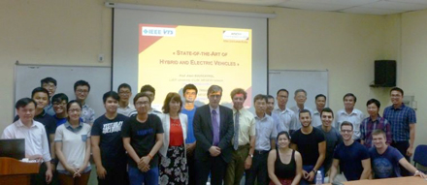
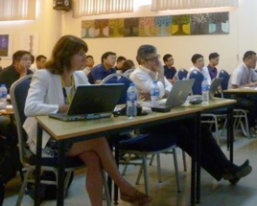
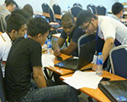
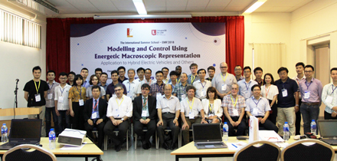
2018: The 11th Energetic Macroscopic Representation International Summer School (EMR’18), Hanoi, Vietnam

Slide 27
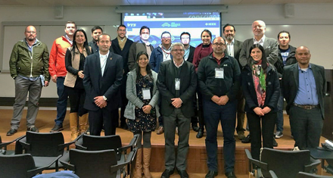
2018: VTS School: V2X communications and networks, Bogotá, Colombia

Slide 28
2019: Launch of IEEE Open Journal of Vehicular Technology

Slide 29
2022: IEEE VTS Awards Luncheon, London, England

Slide 30
2023: Region 10 Chapter Chair Training, Singapore

Slide 31
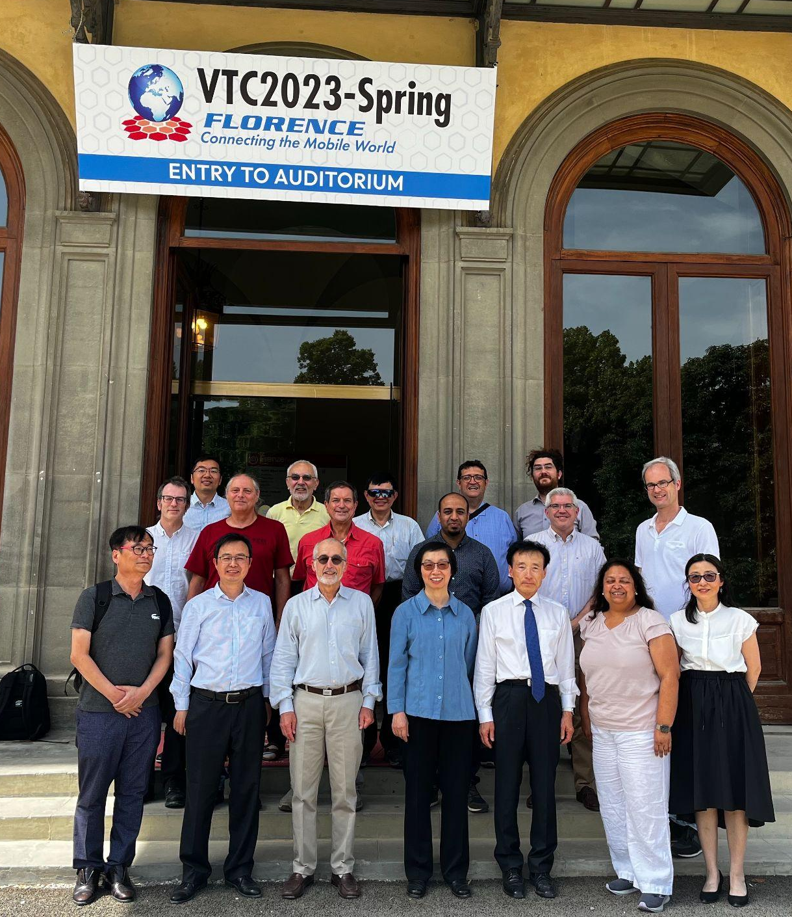
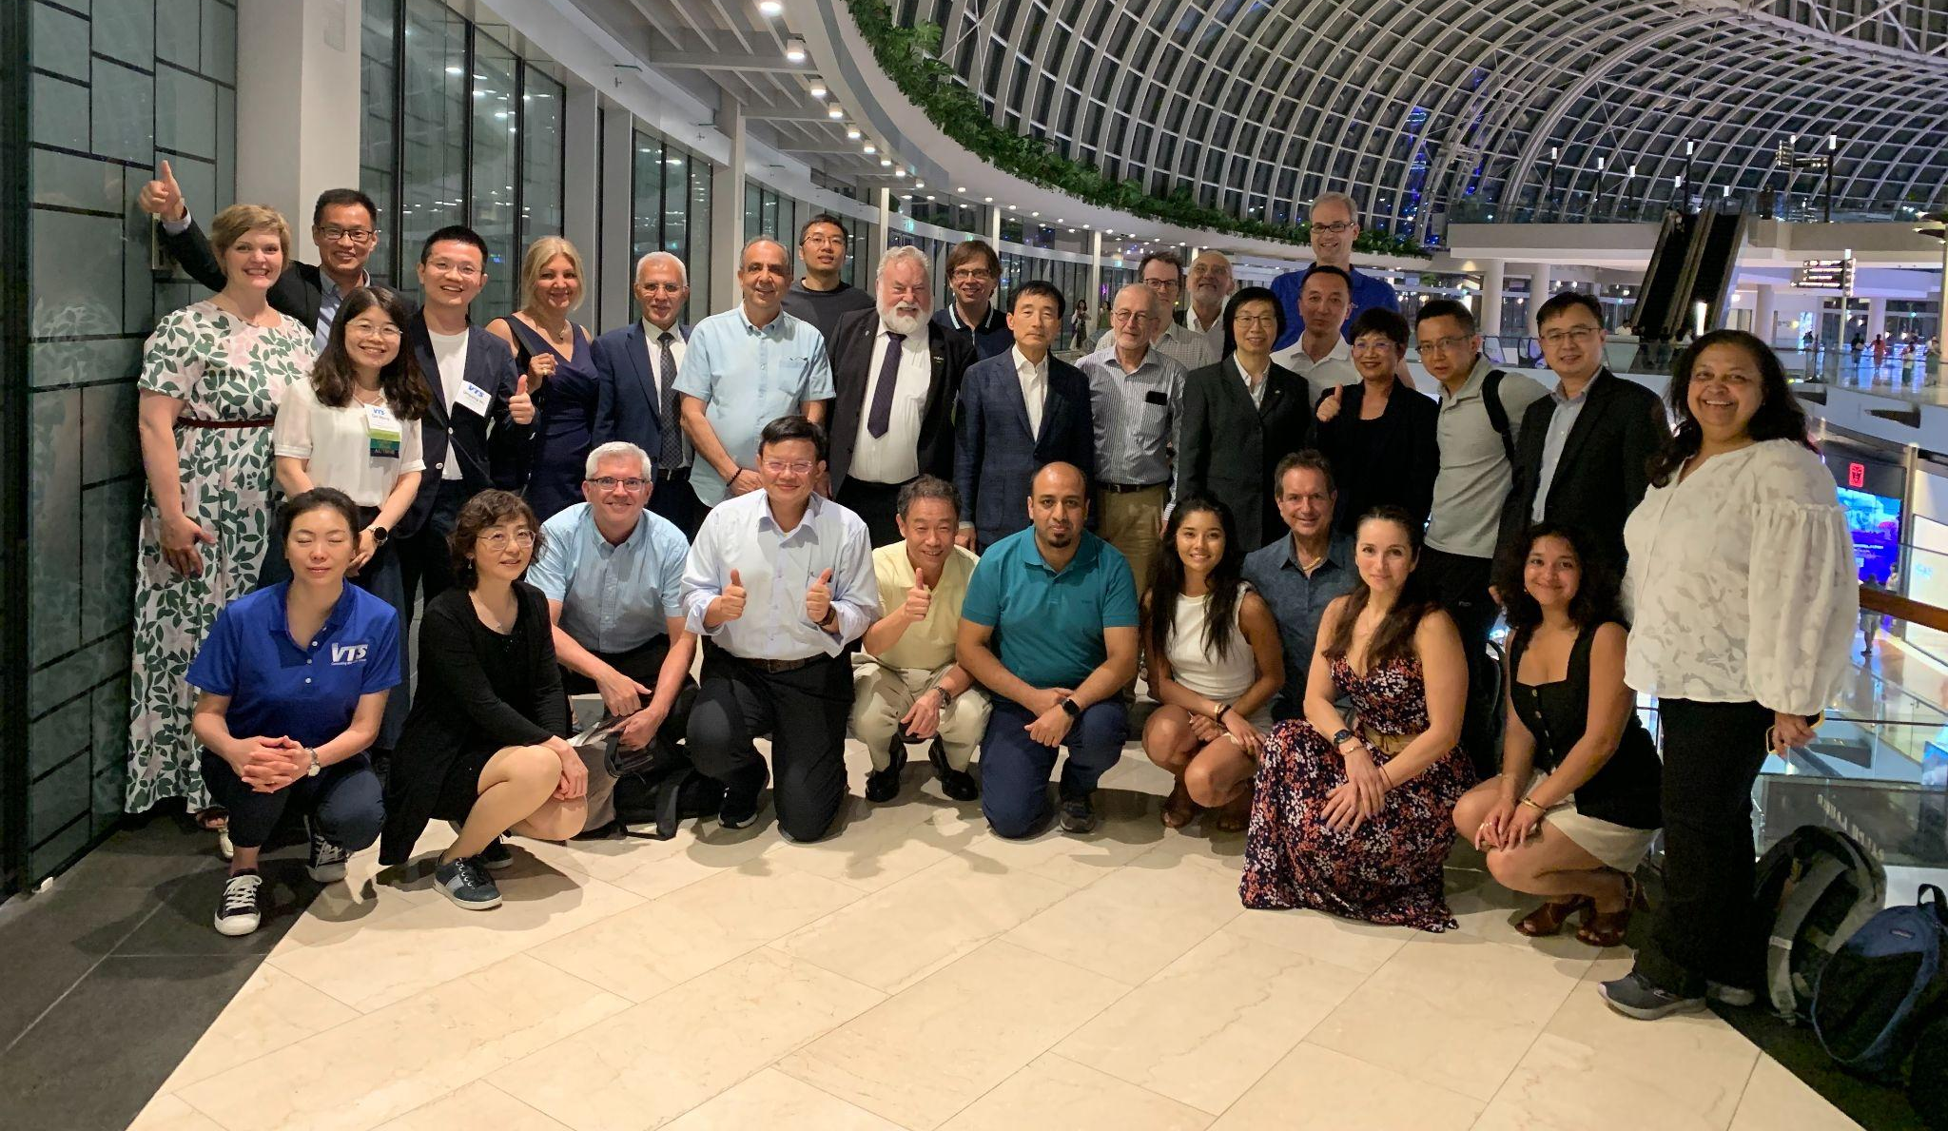
2023-2024: IEEE VTS Board of Governors

Slide 32
2024: Chapter Activities
Clockwise from top left:
Toronto Chapter
Portugal Chapter
Anil Neerukonda Institute Student Branch Chapter
Benelux Chapter

Slide 33
A look back at VTS Conferences

Slide 34
1950: Introducing VTC: 1950 Detroit
The first edition of the Vehicular Technology Conference was held in 1950 in Detroit, with eight technical presentations, six exhibitors, and 94 registered attendees.

Slide 35
1974: 3rd Microwave Mobile Communication Symposium
Invited speaker, Dr. William Jakes, Jr. of Bell Labs, presented, “Bringing order out of chaos - a decade of progress in mobile radio research”.

Slide 36
1975: 25th VTG Conference
“…As you no doubt know, many of your member’s papers have directly influence the department’s action in connection with vehicular communications. In fact – in our department, in many instances, your papers have become major reference documents.”
from the address given in Toronto at the 25th VTG Conference by R.R. Hoodspith, Director General, Telecommunications Regulatory Service, Department of Communications

Slide 37
1978: Conference Sessions
Session: Automatic Vehicle Location Systems
Session: Communications at 800 MHz

Slide 38
1979: Conference Theme
“Tomorrow’s Technology for a Mobile Society”

Slide 39
1989: VTC Kick Off Lunch

Slide 40
1989: Conference Theme
Gate to New Concepts in Vehicular Technology

Slide 41
1990: Conference Theme
On the Move in the ‘90’s

Slide 42
2000/2001
In the year 2000, IEEE VTS offered two Conferences each year, one in North America, and a second which alternated between Europe and Asia.

Slide 43
2001: Conference photos

Slide 44
VTC2002-Fall
Vancouver, British Columbia, Canada

Slide 45
VTC2005-Fall
Dallas, Texas, USA

Slide 46
VTC2006-Spring
Melbourne, Australia

Slide 47
VTC2007-Fall
Baltimore, MD, USA

Slide 48
VTC2008-Spring Singapore

Slide 49
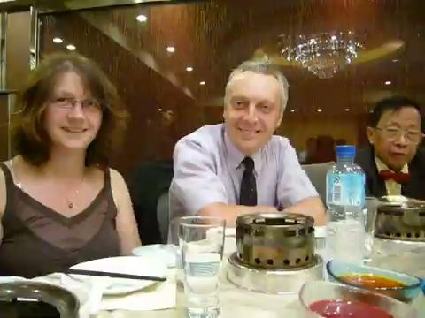
VPPC 2008
Harbin, China

Slide 50
VPPC 2015
Montreal, Canada

Slide 51
VTC2016-Spring
Nanjing, China

Slide 52
VTC2016-Fall Montreal, Canada

Slide 53
VTC2017-Fall
Toronto, Canada

Slide 54
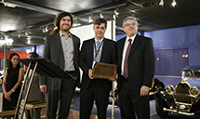
VPPC 2017
Belfort, France

Slide 55
1st Wireless Africa Conference, 2018
Addis Ababa, Ethiopia

Slide 56
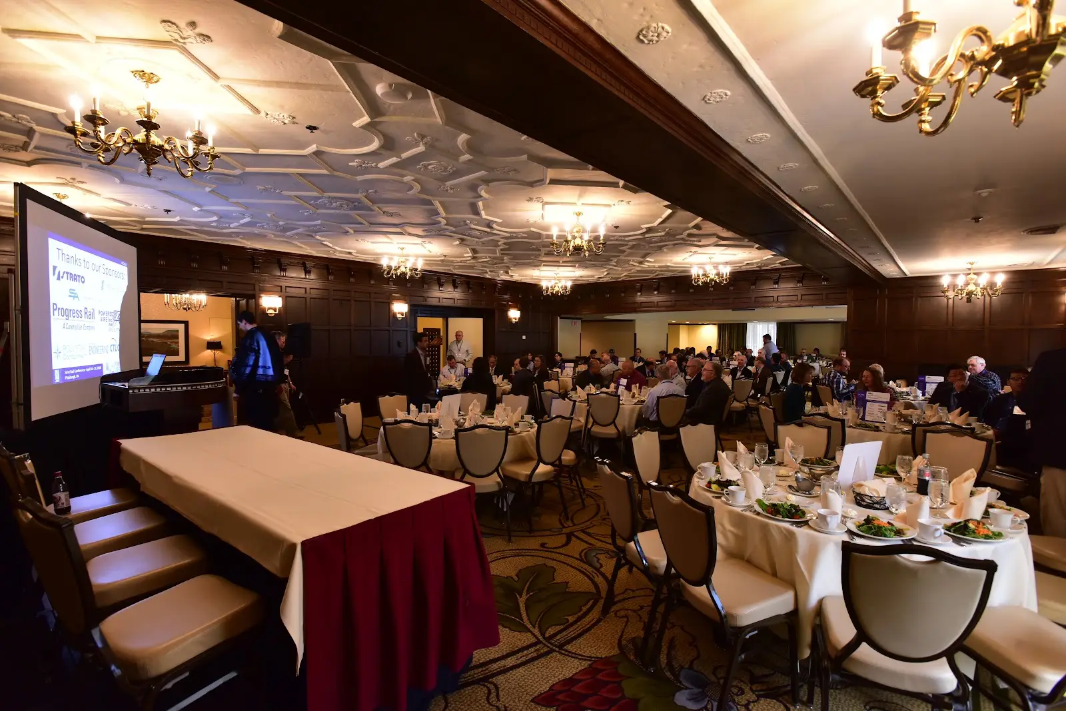
Joint Rail Conference 2018
Pittsburgh, PA, USA

Slide 57
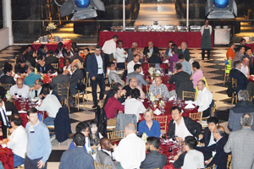
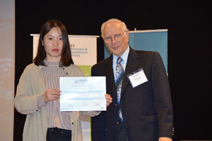
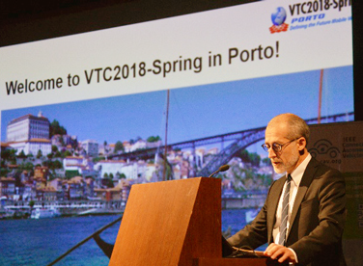
VTC2018-Spring Porto, Portugal

Slide 58
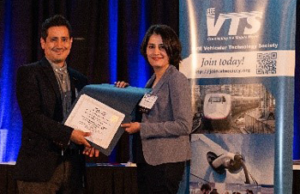
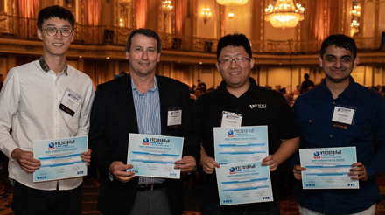
VTC2018-Fall
VPPC 2018
Chicago, IL, USA

Slide 59
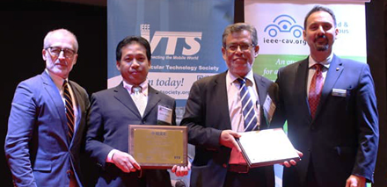
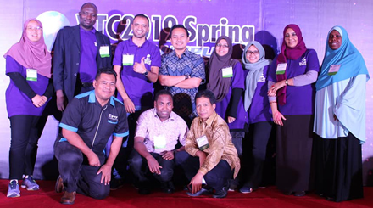
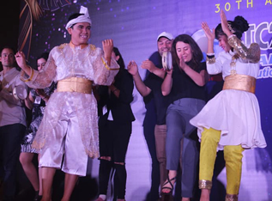
VTC2019-Spring
Kuala Lumpur, Malaysia

Slide 60
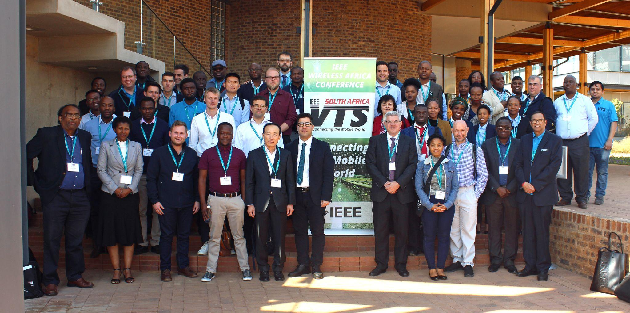
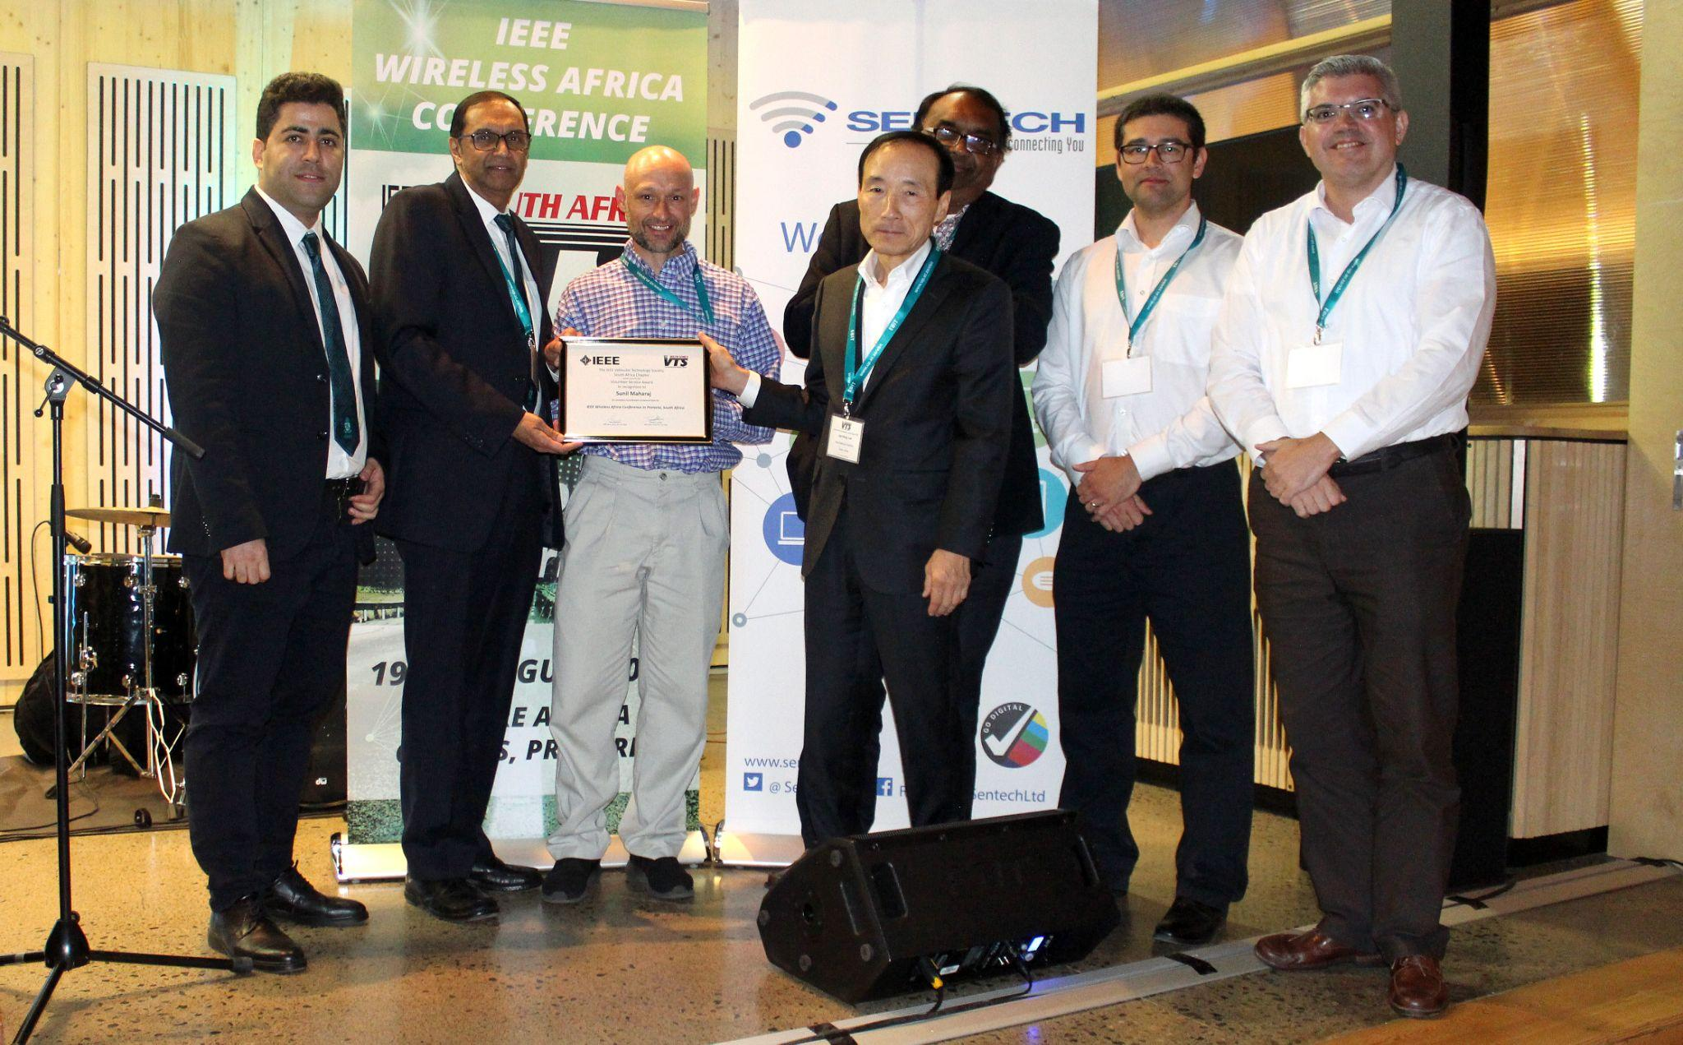
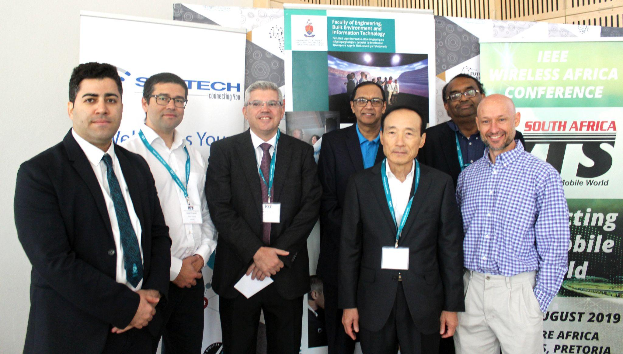
Wireless Africa 2019
Pretoria, South Africa

Slide 61
VTC2022-Fall
London, England
Beijing, China

Slide 62
VPPC 2022
Merced, CA, USA

Slide 63
VTC2023-Fall
Hong Kong

Slide 64
VTC2024-Spring
Singapore

